Slide 1
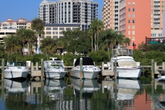
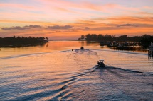
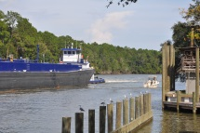
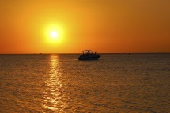
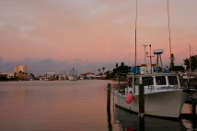
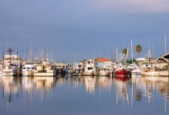





SAVE THE DATE
4th National Working Waterfronts & Waterways Symposium
November 16-19, 2015 │ Downtown Tampa, FL
www.conference.ifas.ufl.edu/NWWWS
@NWWWS2015 #NWWWS2015
Sponsorship Opportunities Available
Visit the website for details or email mstage@ufl.edu

